Slide 1

PROFESSIONAL TRAINING YEAR OPERATIONAL SUPPORT ENGINEER
DAVID ENYI

Slide 2
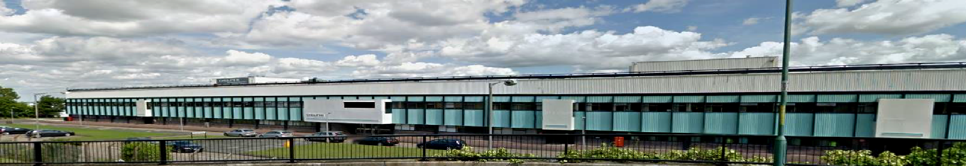
INTRODUCTION
Company Overview
Delphi is an Internationally renowned precision automotive engineering company.
Gillingham is part of the Delphi Powertrain Systems and includes both a technical centre and operations site which together mainly design, develop and manufacture Diesel pumps & Variable Cam Phasers.
Role Overview
Ensuring that quality of products meets up to an acceptable standard.
Operational Support Engineers assist manufacturing lines in achieving site Safety, Quality, Volume and Cost metrics.
Enhancing productivity of operations via Lean manufacturing techniques.
Minimising waste and the manufacturing cost of the product.
Root cause investigation of daily quality non-conformances.

Slide 3
PROJECT INVOLVEMENT
Variable Cam Phaser measurement study (Renault) .
A3 problem solving (911 dept.)
In-house non-conformance measurement study.
Initializing setup for DTVS Hydraulic head correlation and consequent weekly checks.
Pre-delivery inspection station setup
Reference piece {master} setup head grade.
Lost time management setup on key machines
Work Instruction development (912 TP Rotors)

Slide 4
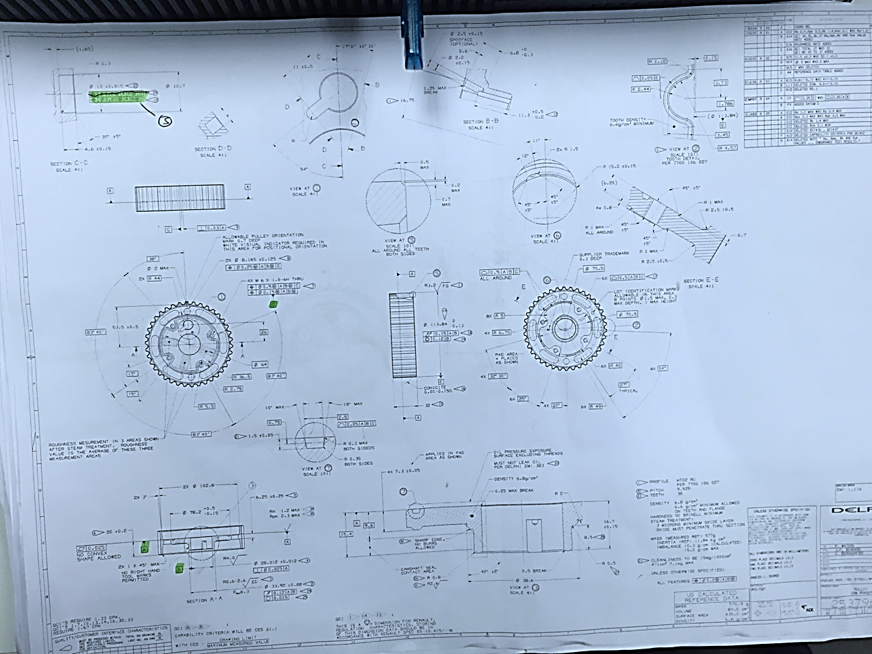
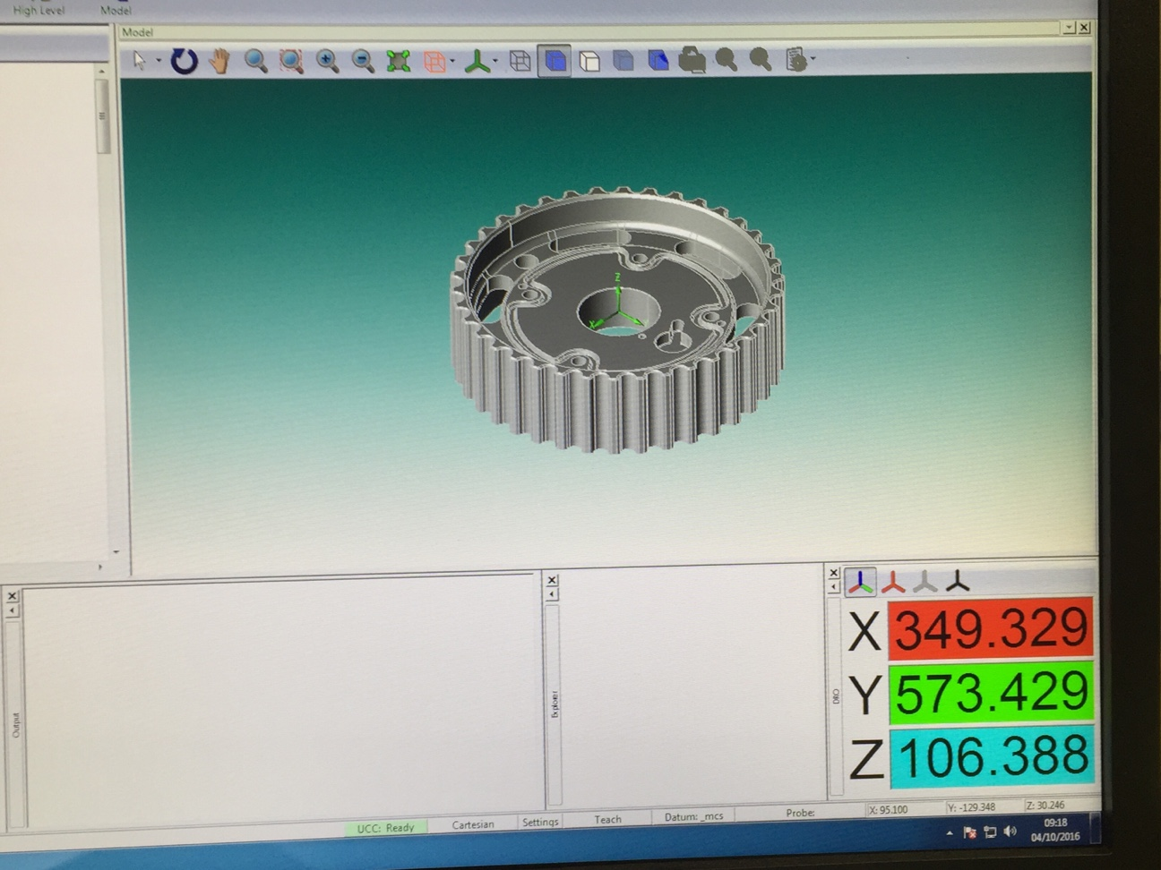
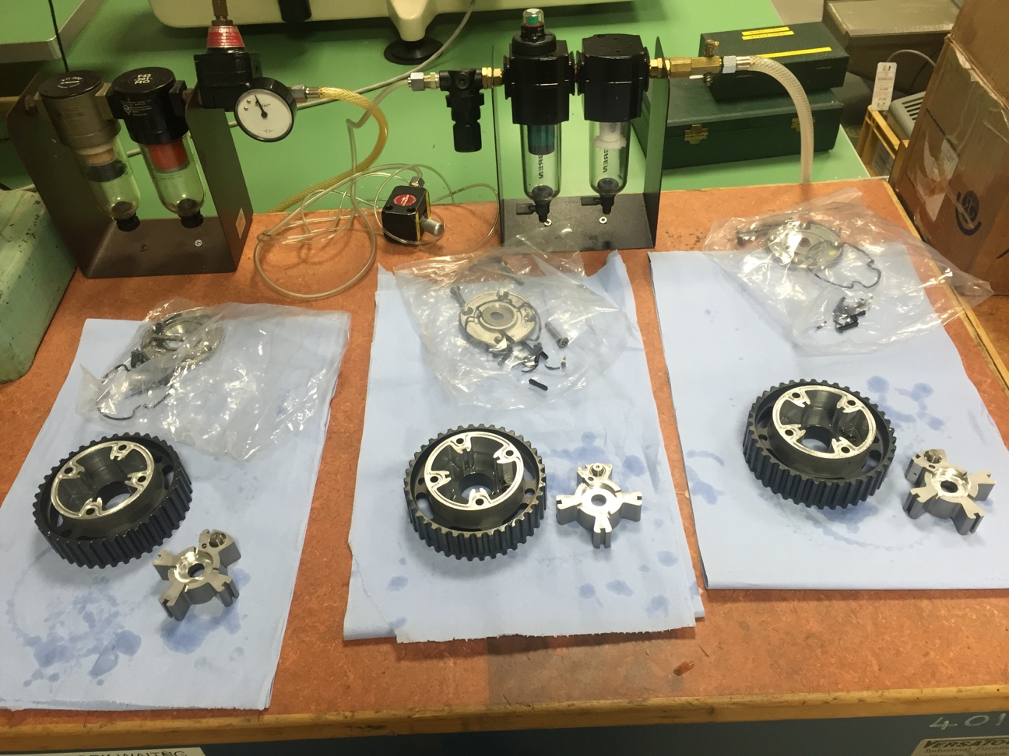
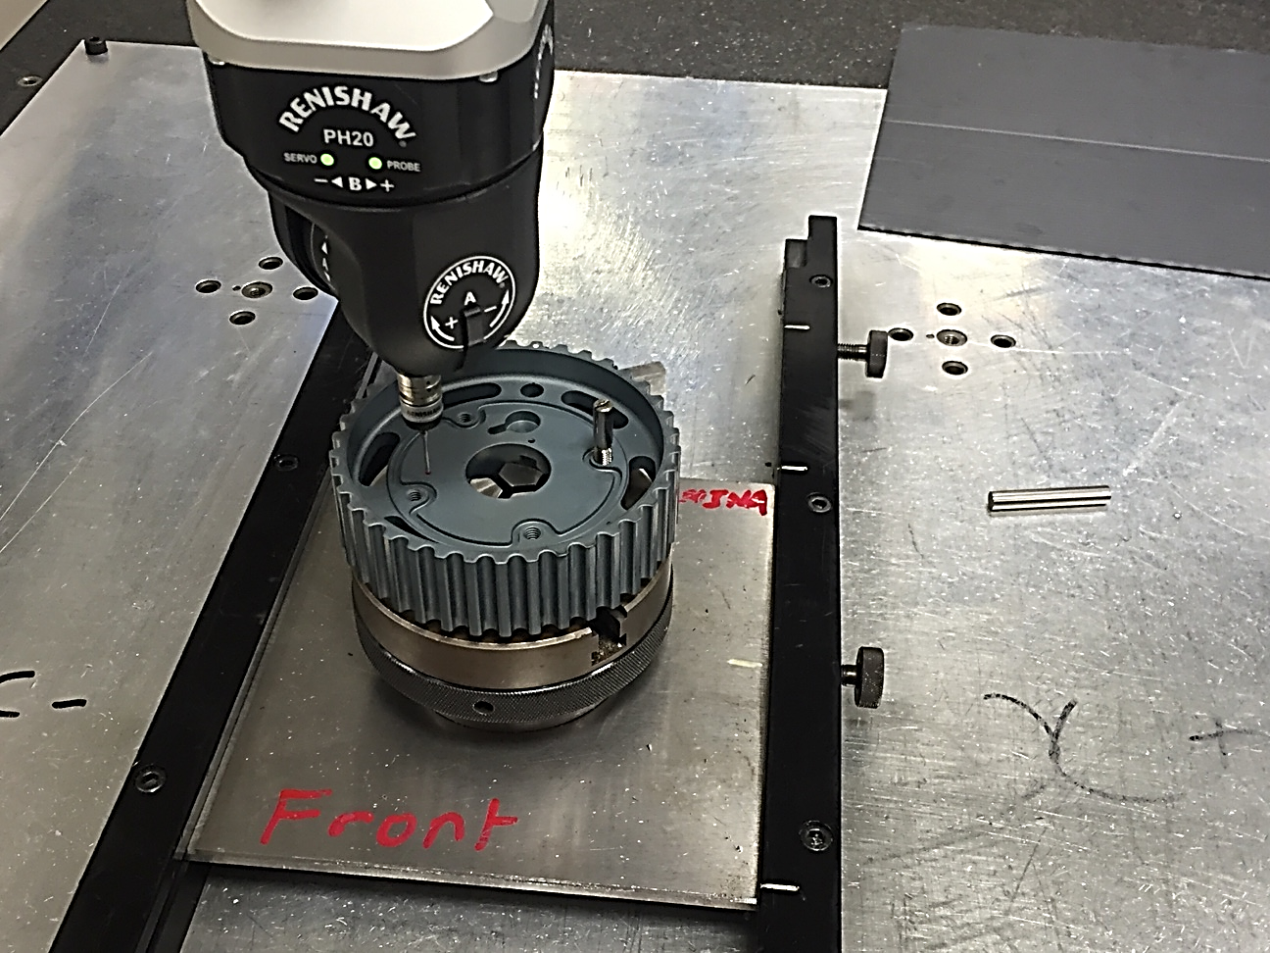
VARIABLE CAM PHASER PROJECT
Stage 1- Data extrapolation & fixturing
Stage 2- Manual vs Automatic/program alignment

Slide 5






GEOMETRIC PARAMETERS MEASURED
Diameter Tolerance : 0.012 mm
True Position Tolerance :
Roughness Average Tolerance : 0.008 mm/ 0.8 µm
Total Runout Tolerance: 0.025 mm
Coaxiality Tolerance: 0.010 mm

Slide 6
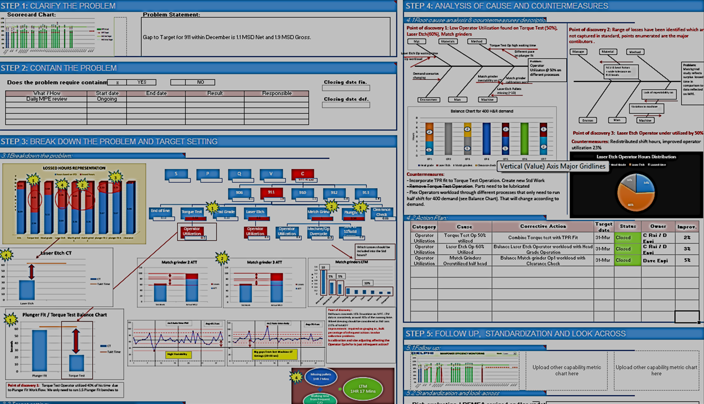
A3 PROBLEM SOLVING
Methodology
Clarify problem
Containment
Breakdown
Analyses of causes & countermeasures.
Standardization
10% Improvement (operator utilization)
Global PT Lean EOS Monthly Communication EMEA + Americas MAY

Slide 7
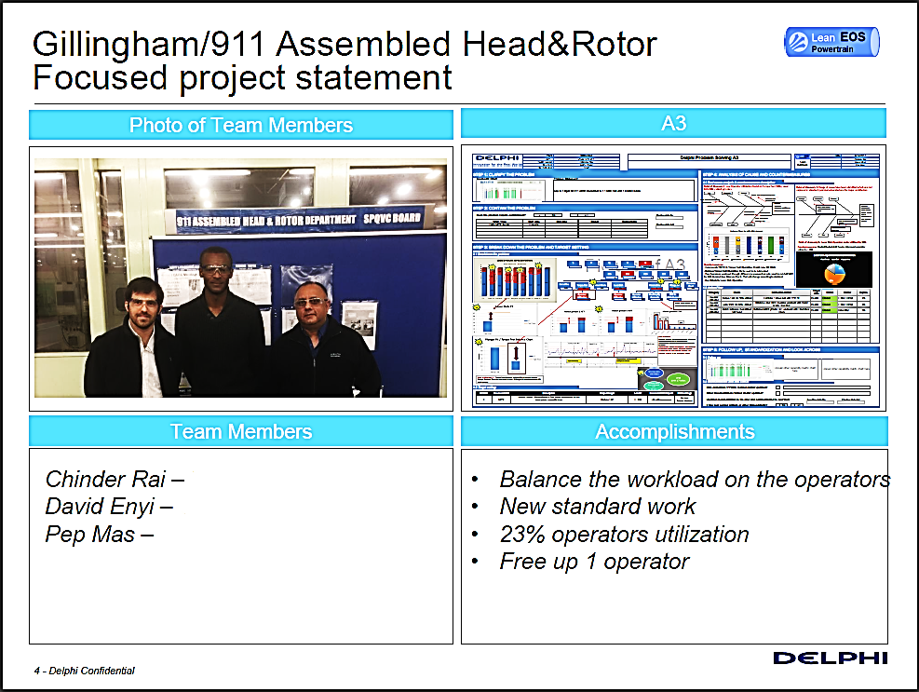
Team Leader
Manufacturing Engineer {Student}
Lean/IE Engineer

Slide 8
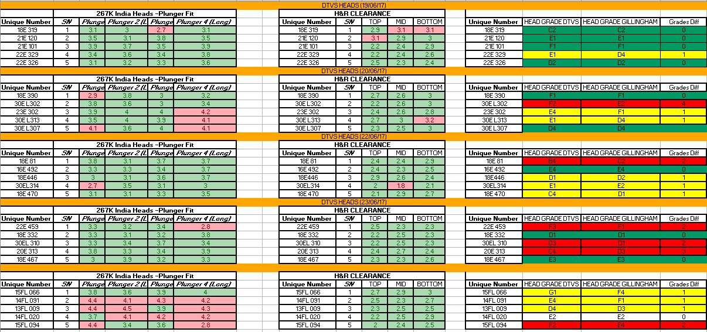
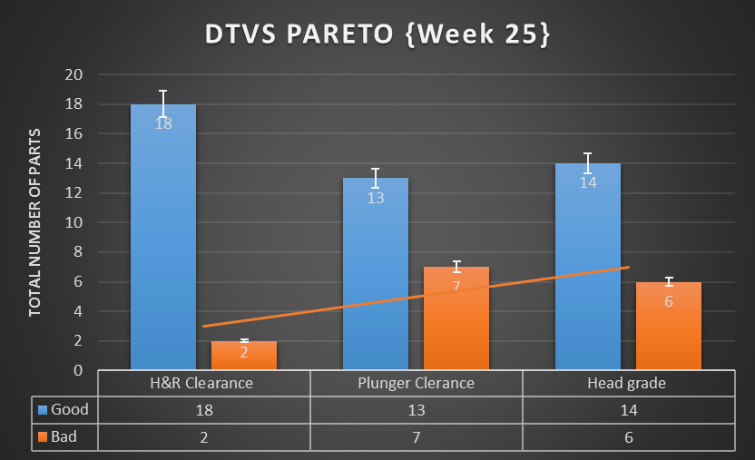
DELPHI INDIA CORELATION EXERCISE

Slide 9
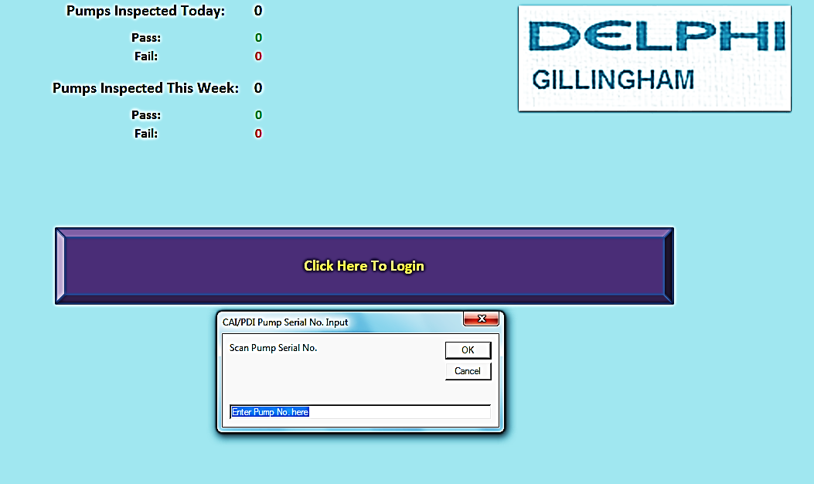
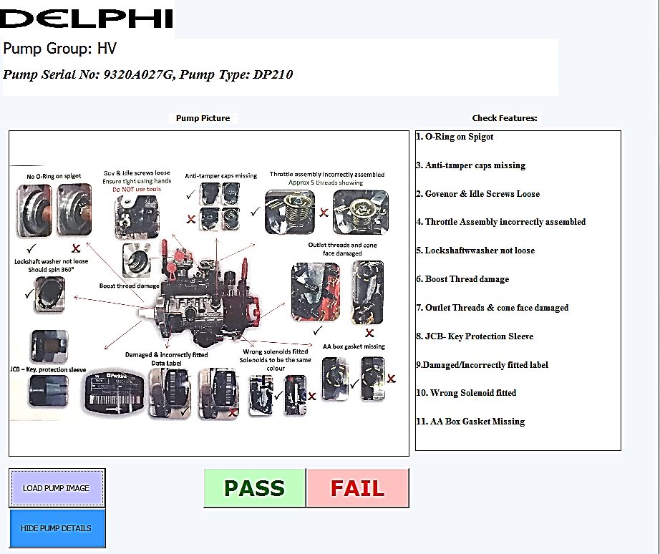
PRE-DELIVERY INSPECTION {VBA}

Slide 10
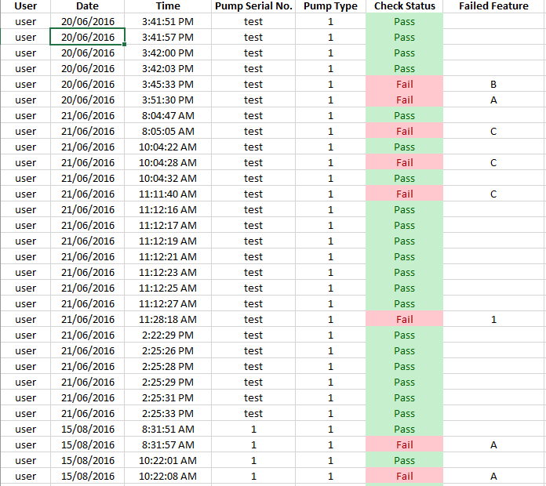
PROGRAM DATABASE
IMPROVEMENTS
More robust system
Guaranteed validation of product before delivery to customer
Mitigation of operator oversight (POKA YOKE).
Effective storage of dispatch information in database.
Live counter to track daily and weekly output from station.

Slide 11
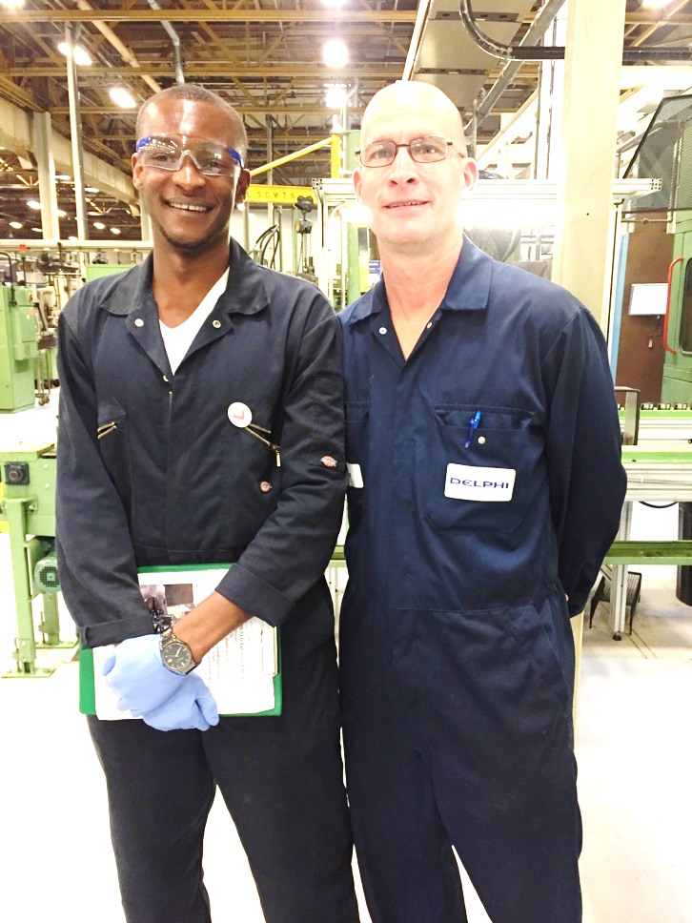
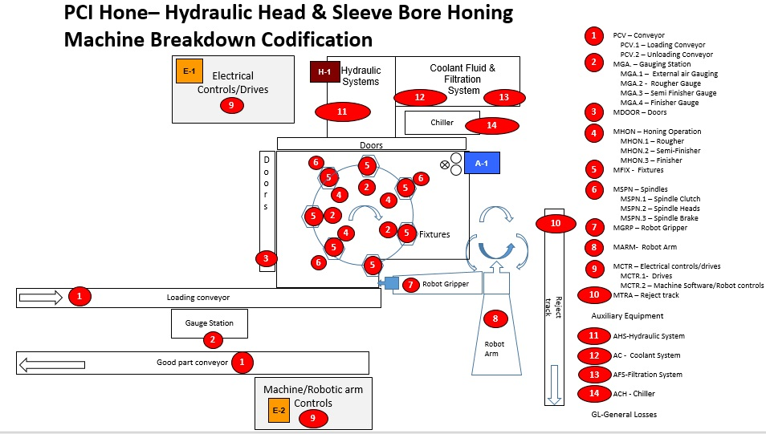
PCI DEVELOPMENT

Slide 12
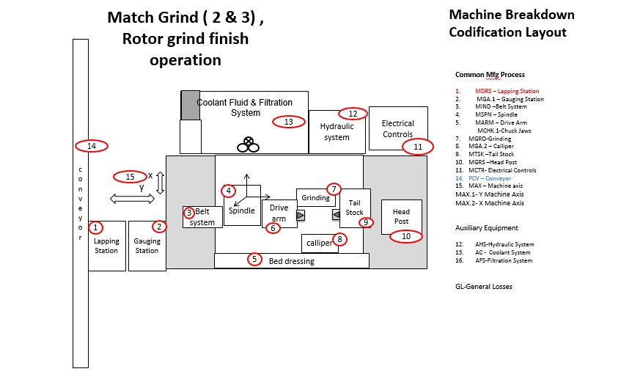
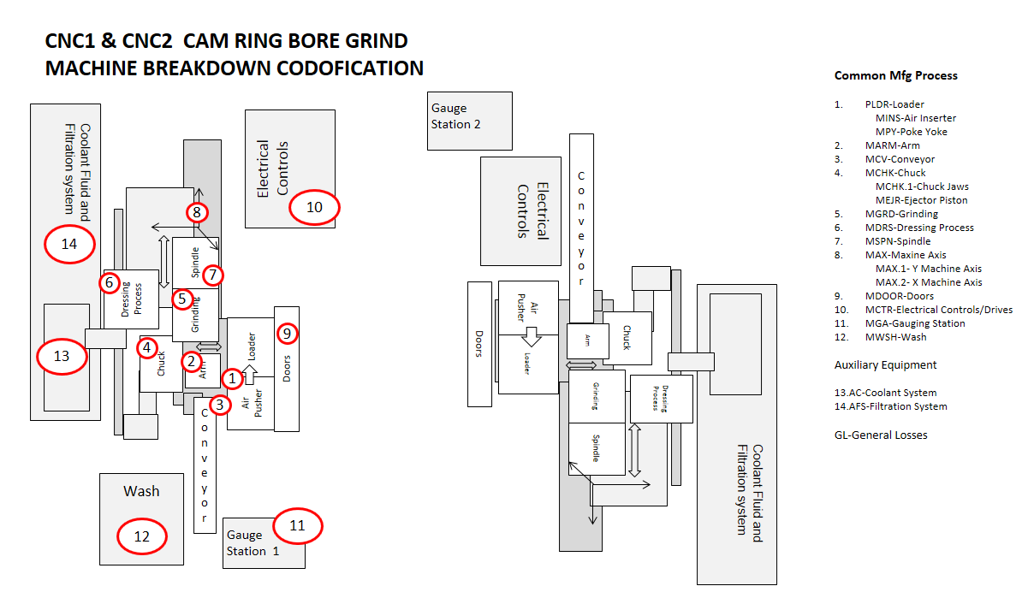
LOST TIME MANAGEMENT – MACHINE CODIFICATION

Slide 13
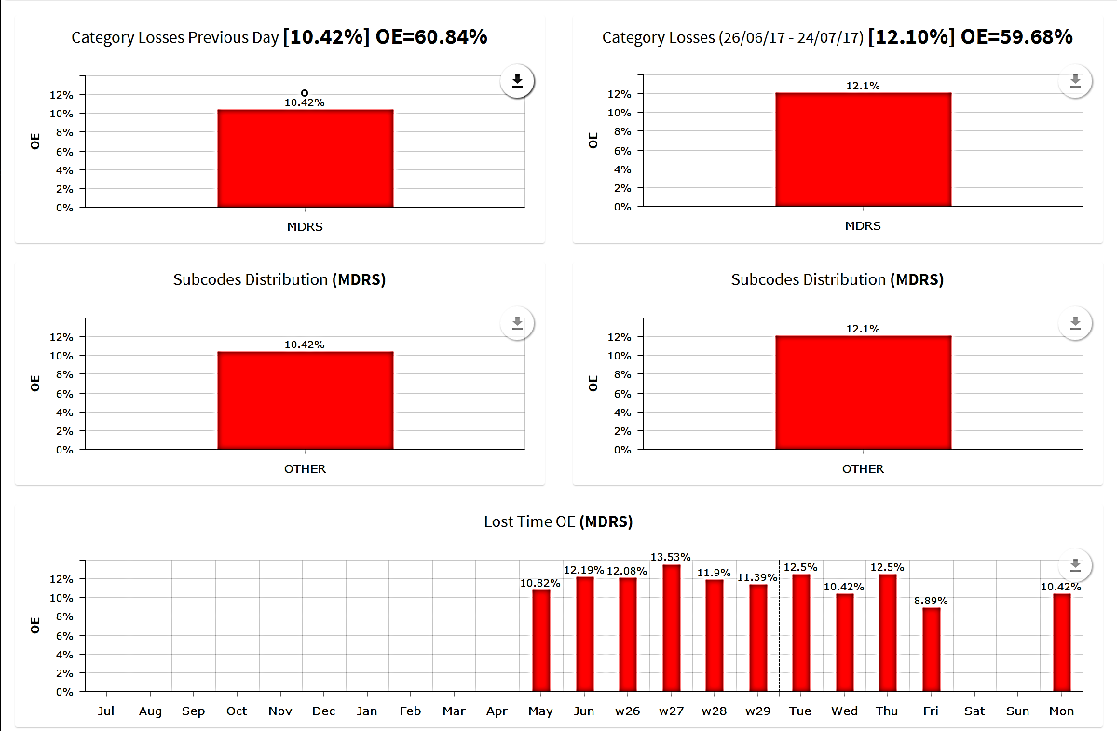
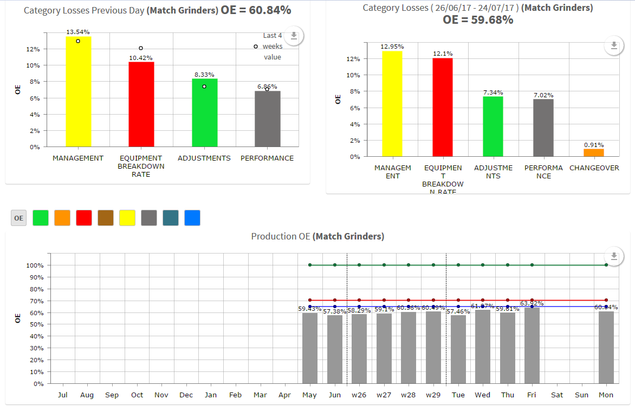
LTM REPORTS

Slide 14
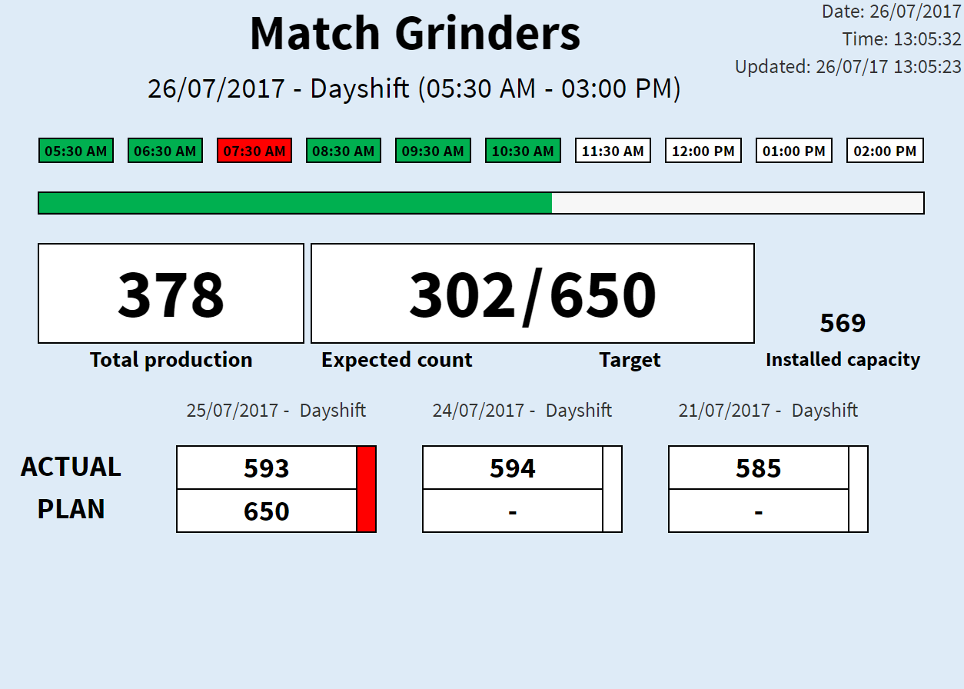
LTM – PRODUCTION STATUS DISPLAYS

Slide 15
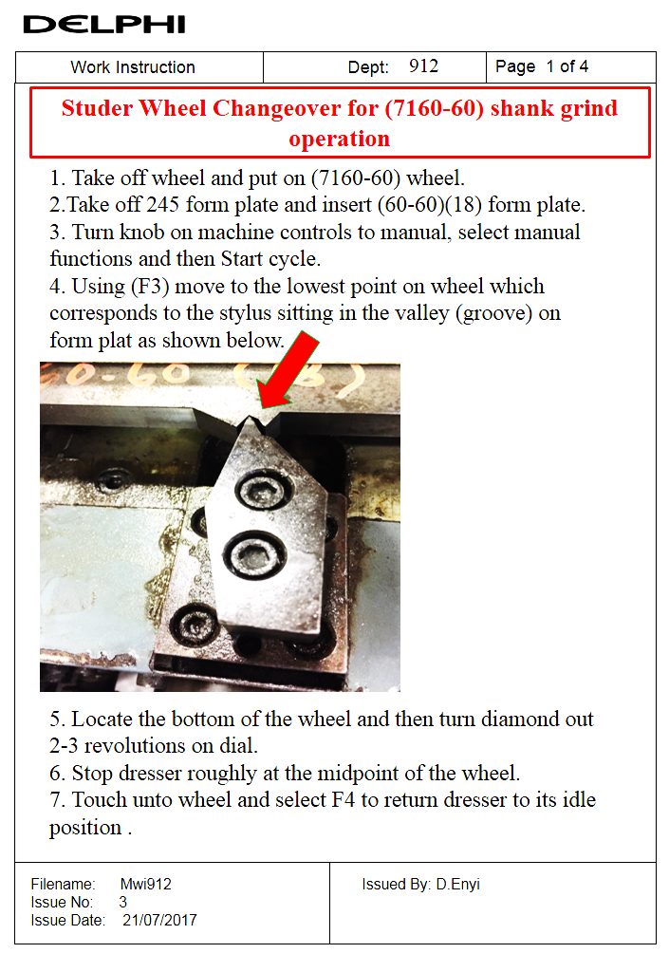
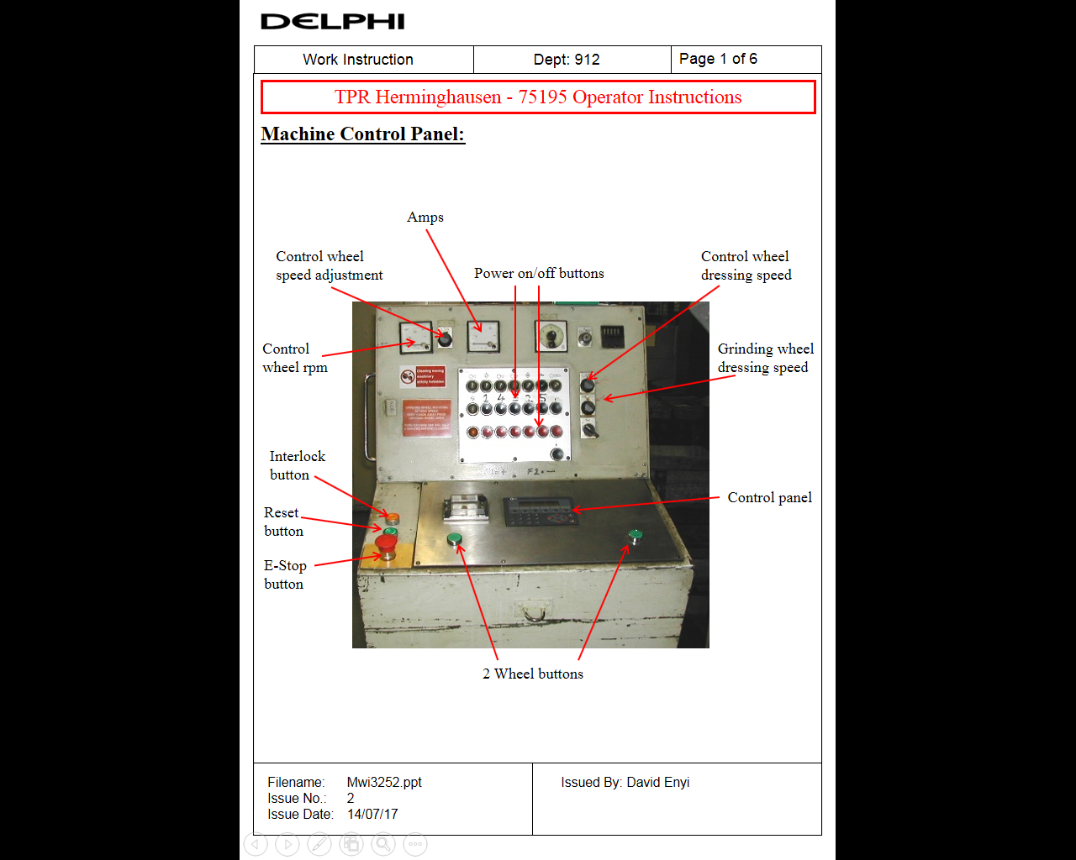
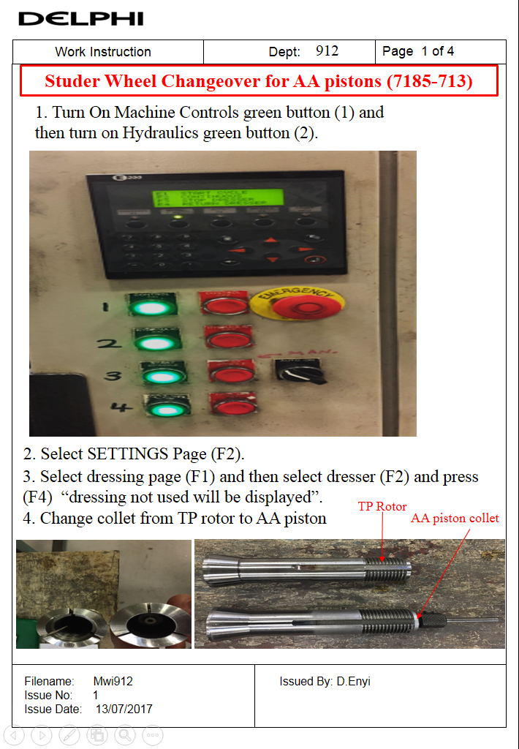
WORK INSTRUCTIONS {912 TP ROTORS}

Slide 16
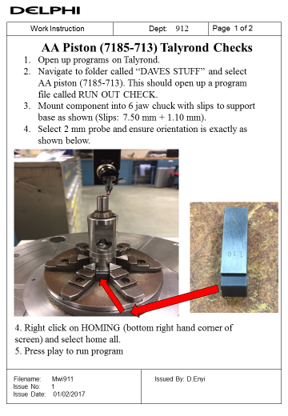
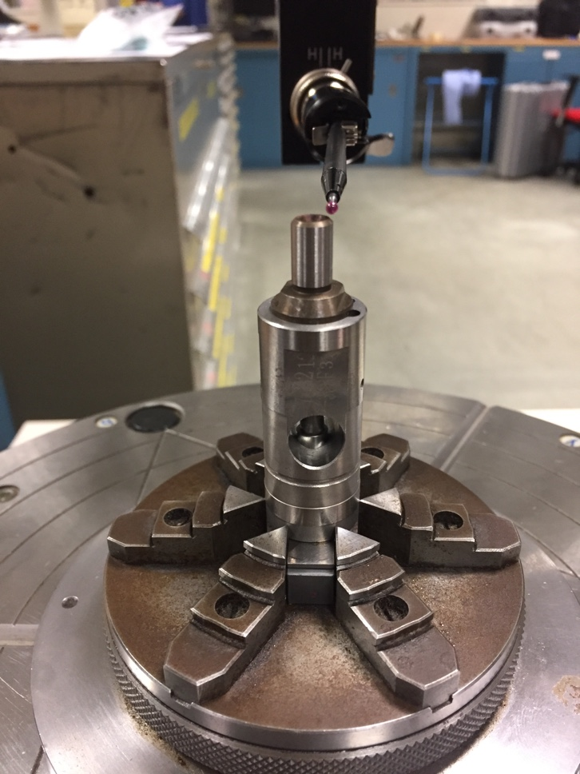
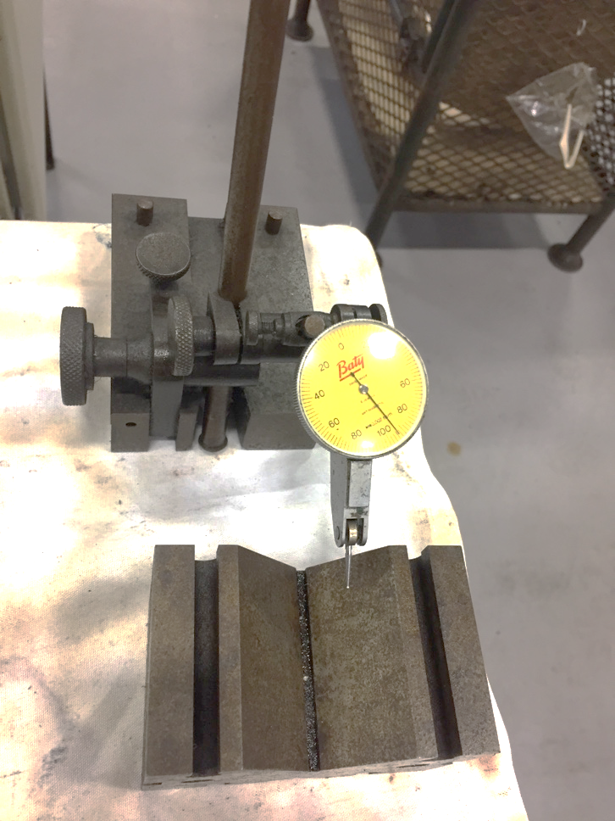
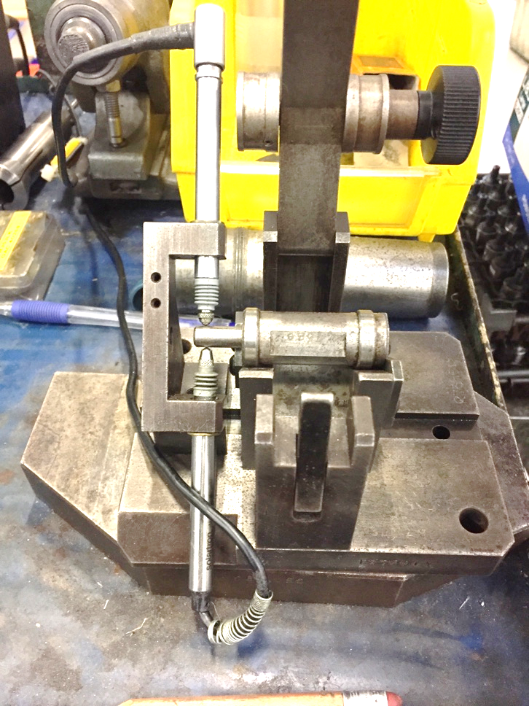
GAUGING IMPROVEMENT
WORK INSTRUCTION
NEW GAUGING SETUP
OLD GAUGING SETUP

Slide 17
LEARNING EXPERIENCE
Manufacturing Engineering
Greater understanding of manufacturing methods
Knowledge of manufacturing capabilities
Problem Solving using KPI (lean techniques).
Metrology Analysis
Development Support (PCI HONE).
Machine Tools development
Programming
Learned Visual Basic for Applications
CMM/Talyrond programming
Soft skills
Team work
Communication
Confidence
Project Management
Commercial Awareness
Better understanding of how an International business operates {2018 powertrain spin off, 2040 diesel engine policy. }

